Slide 1

Chapter Four
Uninformed search strategies

Slide 2
Learning objectives.
4.1 Introduction
4.2 Breadth first search
4.3 Depth first search
4.4 Difference between BFS and DFS
4.5 Uniform cost search
4.6 Depth-limited search
4.7 Iterative-deeping DFs
4.8 Bidirectional Search
4.9 Comparison of uninformed search
After this chapter , students will be able to :
Understand the concept of uninformed search
Apply various techniques of uninformed search on various applications
Identify, contrast and apply simple examples the major search techniques have been developed for problem-solving in artificial intelligence

Slide 3
Introduction
4.1 Introduction
4.2 Breadth first search
4.3 Depth first search
4.4 Difference between BFS and DFS
4.5 Uniform cost search
4.6 Depth-limited search
4.7 Iterative-deeping DFs
4.8 Bidirectional Search
4.9 Comparison of uninformed search
The uniformed search is also known as Blind Search. Therefore, we can also say that this type of search implies that these provide no extra information reading the states except information given by the definition of problem. Also, blind search might generate successor states distinguishing between a goal state and a non-goal state.
Blind search or brute force is a uniformed exploration of the search space, which does not take into account either execution efficiency or planning efficiency. Blind search is also known as uniform search.

Slide 4
4.1 Introduction
4.2 Breadth first search
4.3 Depth first search
4.4 Difference between BFS and DFS
4.5 Uniform cost search
4.6 Depth-limited search
4.7 Iterative-deeping DFs
4.8 Bidirectional Search
4.9 Comparison of uninformed search
Uninformed (blind) search strategies use only the information available in the problem definition:
Breadth-first search
Uniform-cost search
Depth-first search
Depth-limited search
Iterative deepening search
Bidirectional search
Key issue: type of queue used for the fringe of the search tree
(collection of tree nodes that have been generated but not yet expanded)

Slide 5
Blind Strategies(uniform search)
4.1 Introduction
4.2 Breadth first search
4.3 Depth first search
4.4 Difference between BFS and DFS
4.5 Uniform cost search
4.6 Depth-limited search
4.7 Iterative-deeping DFs
4.8 Bidirectional Search
4.9 Comparison of uninformed search
Breadth-first
Bidirectional
Depth-first
Depth-limited
Iterative deepening
Uniform-Cost (variant of breadth-first)
Arc cost = 1
Arc cost
= c(action) ≥ ε > 0

Slide 6
Breadth first search
4.1 Introduction
4.2 Breadth first search
4.3 Depth first search
4.4 Difference between BFS and DFS
4.5 Uniform cost search
4.6 Depth-limited search
4.7 Iterative-deeping DFs
4.8 Bidirectional Search
4.9 Comparison of uninformed search
A basic technique of traversing a graph is breadth-first search or BFS. It first finds the shortest path always; however, this might also lead to using of more memory. The state space is shown in the form of a tree in this type of search.
One can obtain the solution by traversing through the tree. The nodes of the tree display the start value or starting state, various intermediate states and the final state.
Each node in the search tree is developed breadth-wise at each level.

Slide 7
Breadth first search ALGORITHM
4.1 Introduction
4.2 Breadth first search
4.3 Depth first search
4.4 Difference between BFS and DFS
4.5 Uniform cost search
4.6 Depth-limited search
4.7 Iterative-deeping DFs
4.8Bidirectional Search 4.9 Comparison of uninformed search
Begin
Initially, OPEN has the root node and CLOSE is EMPTY OPEN=[start]
CLOSE=[ ]
The loop is continued till OPEN list is not EMPTY While OPEN [] do
Begin
Remove the leftmost state from OPEN and let it be X
If X is GOAL then Return SUCCESS Else
Begin
Generate children of x
Substitute x on close.
Discard the children of x if already on OPEN or CLOSE.
Place the remaining children on the right side of the OPEN.
(For BFS, we place the children to the right side of OPEN End)
End

Slide 8
Breadth first search
4.1 Introduction
4.2 Breadth first search
4.3 Depth first search
4.4 Difference between BFS and DFS
4.5 Uniform cost search
4.6 Depth-limited search
4.7 Iterative-deeping DFs
4.8Bidirectional Search 4.9 Comparison of uninformed search
ADVANTAGES
In this procedure, at any way it will find the GOAL.
It does not follow a single unfruitful path for a long time.
It finds the minimal solution in case of multiple paths.
DISADVANTAGES
Large memory space is consumed by BFS.
Time complexity is more.
It also has long pathways, when all the paths to a destination are on approximately the same search depth.

Slide 9
Breadth-First Strategy
4.1 Introduction
4.2 Breadth first search
4.3 Depth first search
4.4 Difference between BFS and DFS
4.5 Uniform cost search
4.6 Depth-limited search
4.7 Iterative-deeping DFs
4.8Bidirectional Search 4.9 Comparison of uninformed search
New nodes are inserted at the end of FRINGE
FRINGE = (1)
1
2
3
4
5
6
7

Slide 10
Breadth-First Strategy
4.1 Introduction
4.2 Breadth first search
4.3 Depth first search
4.4 Difference between BFS and DFS
4.5 Uniform cost search
4.6 Depth-limited search
4.7 Iterative-deeping DFs
4.8Bidirectional Search 4.9 Comparison of uninformed search
New nodes are inserted at the end of FRINGE
FRINGE = (2, 3)
1
2
3
4
5
6
7

Slide 11
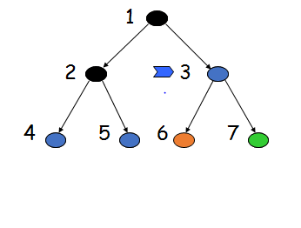
Breadth-First Strategy
4.1 Introduction
4.2 Breadth first search
4.3 Depth first search
4.4 Difference between BFS and DFS
4.5 Uniform cost search
4.6 Depth-limited search
4.7 Iterative-deeping DFs
4.8Bidirectional Search 4.9 Comparison of uninformed search
New nodes are inserted at the end of FRINGE
FRINGE = (3, 4, 5)

Slide 12
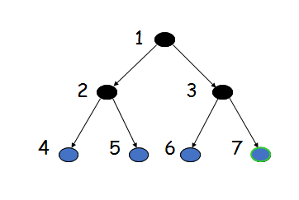
Breadth-First Strategy
4.1 Introduction
4.2 Breadth first search
4.3 Depth first search
4.4 Difference between BFS and DFS
4.5 Uniform cost search
4.6 Depth-limited search
4.7 Iterative-deeping DFs
4.8Bidirectional Search 4.9 Comparison of uninformed search
New nodes are inserted at the end of FRINGE
FRINGE = (4, 5, 6, 7)

Slide 13
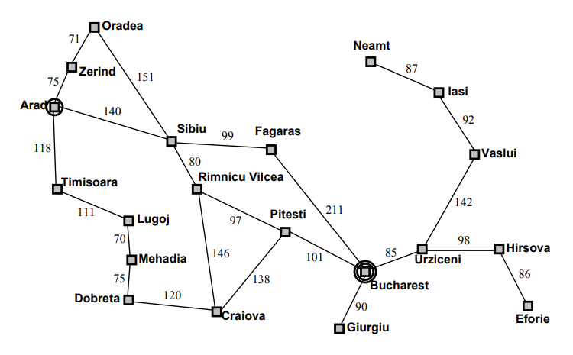
Problem: To find a route from Arad to Bucharest (Romania Problem )
4.1 Introduction
4.2 Breadth first search
4.3 Depth first search
4.4 Difference between BFS and DFS
4.5 Uniform cost search
4.6 Depth-limited search
4.7 Iterative-deeping DFs
4.8Bidirectional Search 4.9 Comparison of uninformed search

Slide 14
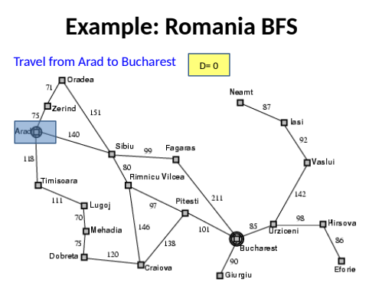
4.1 Introduction
4.2 Breadth first search
4.3 Depth first search
4.4 Difference between BFS and DFS
4.5 Uniform cost search
4.6 Depth-limited search
4.7 Iterative-deeping DFs
4.8Bidirectional Search 4.9 Comparison of uninformed search

Slide 15
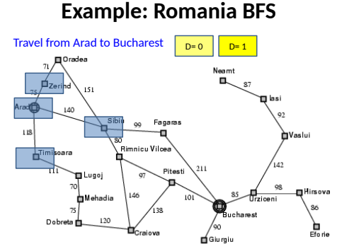
4.1 Introduction
4.2 Breadth first search
4.3 Depth first search
4.4 Difference between BFS and DFS
4.5 Uniform cost search
4.6 Depth-limited search
4.7 Iterative-deeping DFs
4.8Bidirectional Search 4.9 Comparison of uninformed search

Slide 16
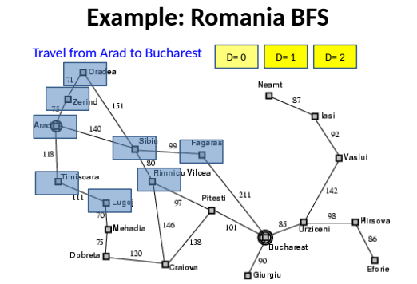
4.1 Introduction
4.2 Breadth first search
4.3 Depth first search
4.4 Difference between BFS and DFS
4.5 Uniform cost search
4.6 Depth-limited search
4.7 Iterative-deeping DFs
4.8Bidirectional Search 4.9 Comparison of uninformed search

Slide 17
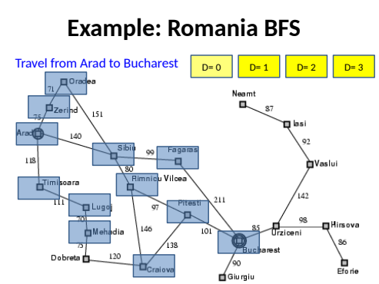
4.1 Introduction
4.2 Breadth first search
4.3 Depth first search
4.4 Difference between BFS and DFS
4.5 Uniform cost search
4.6 Depth-limited search
4.7 Iterative-deeping DFs
4.8Bidirectional Search 4.9 Comparison of uninformed search

Slide 18
Evaluation
4.1 Introduction
4.2 Breadth first search
4.3 Depth first search
4.4 Difference between BFS and DFS
4.5 Uniform cost search
4.6 Depth-limited search
4.7 Iterative-deeping DFs
4.8Bidirectional Search 4.9 Comparison of uninformed search
b: branching factor
d: depth of shallowest goal node
Breadth-first search is:
Complete
Optimal if step cost is 1
Number of nodes generated: 1 + b + b² + … + b^{d} = (b^{d+1}-1)/(b-1) = O(b^{d})
→ Time and space complexity is O(b^{d})

Slide 19
Big O Notation
4.1 Introduction
4.2 Breadth first search
4.3 Depth first search
4.4 Difference between BFS and DFS
4.5 Uniform cost search
4.6 Depth-limited search
4.7 Iterative-deeping DFs
4.8Bidirectional Search 4.9 Comparison of uninformed search
g(n) = O(f(n)) if there exist two positive constants a and N such that:
for all n > N: g(n) ≤ a×f(n)

Slide 20
Time and Memory Requirements
4.1 Introduction
4.2 Breadth first search
4.3 Depth first search
4.4 Difference between BFS and DFS
4.5 Uniform cost search
4.6 Depth-limited search
4.7 Iterative-deeping DFs
4.8Bidirectional Search 4.9 Comparison of uninformed search
d | # Nodes | Time | Memory
2 | 111 | .01 msec | 11 Kbytes
4 | 11,111 | 1 msec | 1 Mbyte
6 | ~10⁶ | 1 sec | 100 Mb
8 | ~10⁸ | 100 sec | 10 Gbytes
10 | ~10¹⁰ | 2.8 hours | 1 Tbyte
12 | ~10¹² | 11.6 days | 100 Tbytes
14 | ~10¹⁴ | 3.2 years | 10,000 Tbytes
Assumptions: b = 10; 1,000,000 nodes/sec; 100bytes/node

Slide 21
Time and Memory Requirements
4.1 Introduction
4.2 Breadth first search
4.3 Depth first search
4.4 Difference between BFS and DFS
4.5 Uniform cost search
4.6 Depth-limited search
4.7 Iterative-deeping DFs
4.8Bidirectional Search 4.9 Comparison of uninformed search
d | # Nodes | Time | Memory
2 | 111 | .01 msec | 11 Kbytes
4 | 11,111 | 1 msec | 1 Mbyte
6 | ~10⁶ | 1 sec | 100 Mb
8 | ~10⁸ | 100 sec | 10 Gbytes
10 | ~10¹⁰ | 2.8 hours | 1 Tbyte
12 | ~10¹² | 11.6 days | 100 Tbytes
14 | ~10¹⁴ | 3.2 years | 10,000 Tbytes
Assumptions: b = 10; 1,000,000 nodes/sec; 100bytes/node

Slide 22
4.1 Introduction
4.2 Breadth first search
4.3 Depth first search
4.4 Difference between BFS and DFS
4.5 Uniform cost search
4.6 Depth-limited search
4.7 Iterative-deeping DFs
4.8Bidirectional Search 4.9 Comparison of uninformed search
TIME COMPLEXITY
A hypothetical state space is considered where each state has ‘b’ successors. The root that generates ‘b’ is not the last node generating bd + 1 – d nodes at level d + 1. Thus, the number of nodes generated will be
b + b2 + b3 + … + bd + (bd + 1 – d ).
Hence, the time complexity = O(bd + 1).

Slide 23
Remark
4.1 Introduction
4.2 Breadth first search
4.3 Depth first search
4.4 Difference between BFS and DFS
4.5 Uniform cost search
4.6 Depth-limited search
4.7 Iterative-deeping DFs
4.8Bidirectional Search 4.9 Comparison of uninformed search
If a problem has no solution, breadth-first may run for ever (if the state space is infinite or states can be revisited arbitrary many times)
1
2
3
4
1
2
3
4
5
6
7
8
5
6
7
8
?
9
10
11
12
9
10
11
12
13
14
15
13
15
14

Slide 24
Depth first search
4.1 Introduction
4.2 Breadth first search
4.3 Depth first search
4.4 Difference between BFS and DFS
4.5 Uniform cost search
4.6 Depth-limited search
4.7 Iterative-deeping DFs
4.8 Bidirectional Search
4.9 Comparison of uninformed search
In this, instead of probing the width, one branch of a tree can be explored until the solution is found. Also, it might be decided to terminate the search due to the reason of it either not meeting the dead end, or encountering some previous state, or might be because the process becomes longer than the set time limit. If any of the aforementioned situations is encountered, the process is terminated resulting in a backtracking. A fresh search will be performed on some other branch of the tree, repeating the process until the goal state is reached. This type of technique is known as DFS technique to left.
DFS always expands one of the nodes at the deepest level of the tree. Once the search hits the dead end, that is, the non-goal node with no expansion, the backtracks technique starts at the shallower level and starts expanding from there on.
For the state space with branching factor b and maximum depth m, storage required by DFS is only Nodes bm in contrast to O(b4) of the BFS.

Slide 25
Depth first search
4.1 Introduction
4.2 Breadth first search
4.3 Depth first search
4.4 Difference between BFS and DFS
4.5 Uniform cost search
4.6 Depth-limited search
4.7 Iterative-deeping DFs
4.8 Bidirectional Search
4.9 Comparison of uninformed search
ALGORITHM
Begin
Initially, OPEN has the root node and CLOSE is EMPTY
OPEN=[start] CLOSE=[]
The loop is continued till OPEN list is not EMPTY
While OPEN #[] Begin
The leftmost state is removed from OPEN and is called as X If X=GOAL then
Return SUCCESS Else
Begin
Children of X is generated.
X is placed on close.
The children of X is discarded in case already on OPEN or CLOSE.
The remaining children are placed on the left side of OPEN.
End Return Fall End

Slide 26
Depth first search
4.1 Introduction
4.2 Breadth first search
4.3 Depth first search
4.4 Difference between BFS and DFS
4.5 Uniform cost search
4.6 Depth-limited search
4.7 Iterative-deeping DFs
4.8 Bidirectional Search
4.9 Comparison of uninformed search
ADVANTAGES
DFS requires less memory as only the nodes to the current path are stored.
In case DFS might also find a solution without examining much of the search space decreasing the amount of time associated considerably.
DISADVANTAGES
DFS can be trapped by following a single unfaithful path, which might terminate in a state which has no successors.
Also, no minimal solution is guaranteed by DFS.

Slide 27
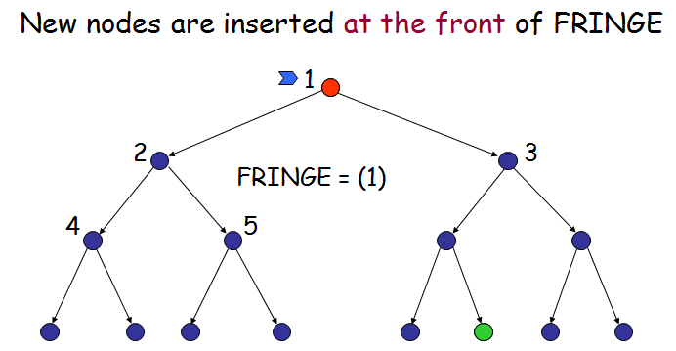
Depth first search
4.1 Introduction
4.2 Breadth first search
4.3 Depth first search
4.4 Difference between BFS and DFS
4.5 Uniform cost search
4.6 Depth-limited search
4.7 Iterative-deeping DFs
4.8 Bidirectional Search
4.9 Comparison of uninformed search

Slide 28
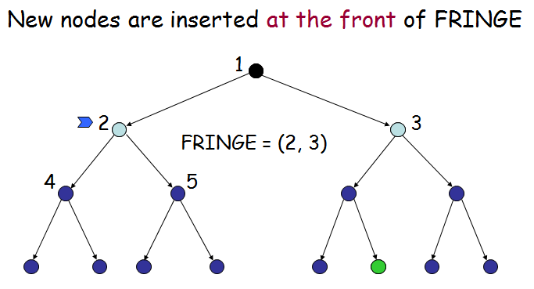
Depth first search
4.1 Introduction
4.2 Breadth first search
4.3 Depth first search
4.4 Difference between BFS and DFS
4.5 Uniform cost search
4.6 Depth-limited search
4.7 Iterative-deeping DFs
4.8 Bidirectional Search
4.9 Comparison of uninformed search

Slide 29
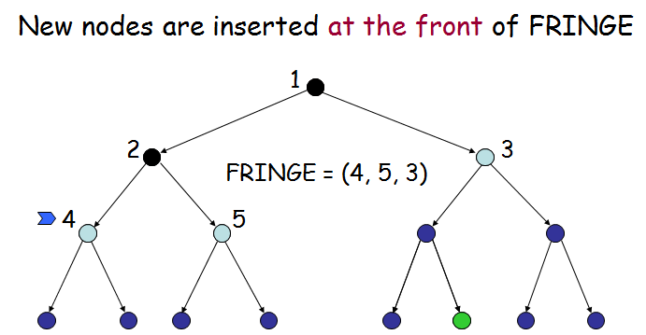
Depth first search
4.1 Introduction
4.2 Breadth first search
4.3 Depth first search
4.4 Difference between BFS and DFS
4.5 Uniform cost search
4.6 Depth-limited search
4.7 Iterative-deeping DFs
4.8 Bidirectional Search
4.9 Comparison of uninformed search

Slide 30
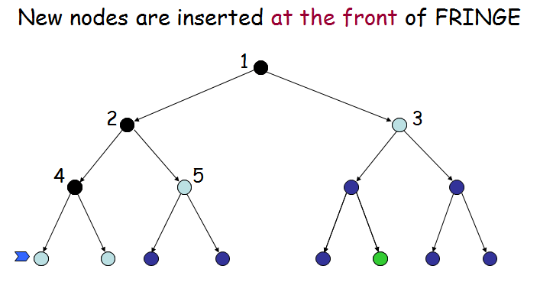
Depth first search
4.1 Introduction
4.2 Breadth first search
4.3 Depth first search
4.4 Difference between BFS and DFS
4.5 Uniform cost search
4.6 Depth-limited search
4.7 Iterative-deeping DFs
4.8 Bidirectional Search
4.9 Comparison of uninformed search

Slide 31
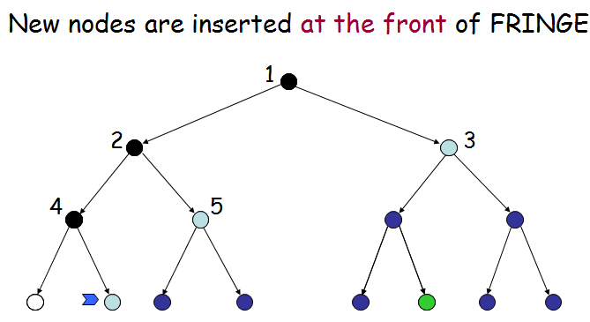
Depth first search
4.1 Introduction
4.2 Breadth first search
4.3 Depth first search
4.4 Difference between BFS and DFS
4.5 Uniform cost search
4.6 Depth-limited search
4.7 Iterative-deeping DFs
4.8 Bidirectional Search
4.9 Comparison of uninformed search

Slide 32
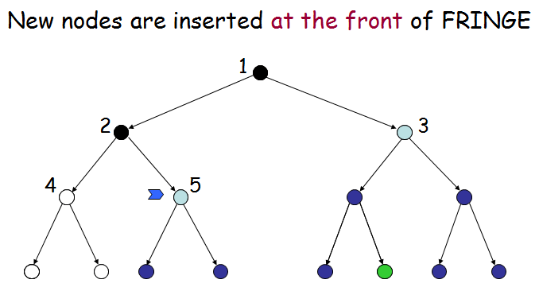
Depth first search
4.1 Introduction
4.2 Breadth first search
4.3 Depth first search
4.4 Difference between BFS and DFS
4.5 Uniform cost search
4.6 Depth-limited search
4.7 Iterative-deeping DFs
4.8 Bidirectional Search
4.9 Comparison of uninformed search

Slide 33
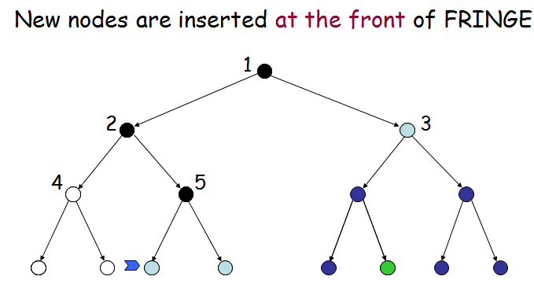
Depth first search
4.1 Introduction
4.2 Breadth first search
4.3 Depth first search
4.4 Difference between BFS and DFS
4.5 Uniform cost search
4.6 Depth-limited search
4.7 Iterative-deeping DFs
4.8 Bidirectional Search
4.9 Comparison of uninformed search

Slide 34
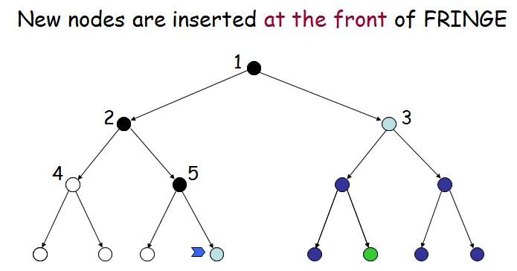
Depth first search
4.1 Introduction
4.2 Breadth first search
4.3 Depth first search
4.4 Difference between BFS and DFS
4.5 Uniform cost search
4.6 Depth-limited search
4.7 Iterative-deeping DFs
4.8 Bidirectional Search
4.9 Comparison of uninformed search

Slide 35
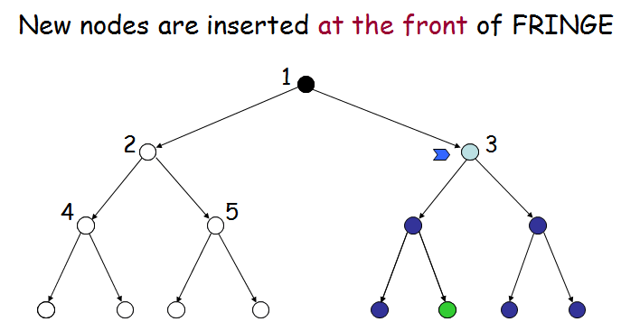
Depth first search
4.1 Introduction
4.2 Breadth first search
4.3 Depth first search
4.4 Difference between BFS and DFS
4.5 Uniform cost search
4.6 Depth-limited search
4.7 Iterative-deeping DFs
4.8 Bidirectional Search
4.9 Comparison of uninformed search

Slide 36
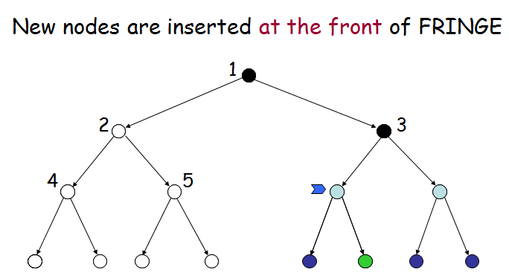
Depth first search
4.1 Introduction
4.2 Breadth first search
4.3 Depth first search
4.4 Difference between BFS and DFS
4.5 Uniform cost search
4.6 Depth-limited search
4.7 Iterative-deeping DFs
4.8 Bidirectional Search
4.9 Comparison of uninformed search

Slide 37
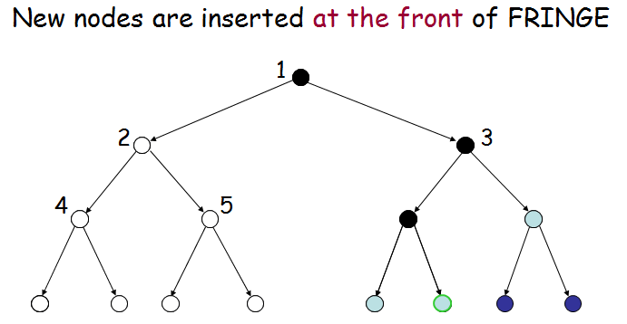
Depth first search
4.1 Introduction
4.2 Breadth first search
4.3 Depth first search
4.4 Difference between BFS and DFS
4.5 Uniform cost search
4.6 Depth-limited search
4.7 Iterative-deeping DFs
4.8 Bidirectional Search
4.9 Comparison of uninformed search

Slide 38
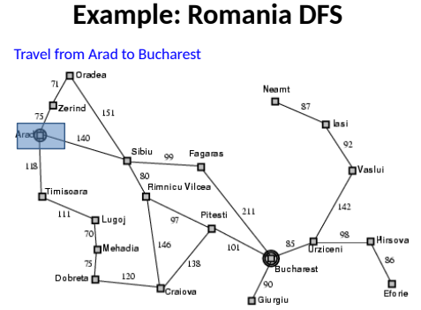
4.1 Introduction
4.2 Breadth first search
4.3 Depth first search
4.4 Difference between BFS and DFS
4.5 Uniform cost search
4.6 Depth-limited search
4.7 Iterative-deeping DFs
4.8 Bidirectional Search
4.9 Comparison of uninformed search

Slide 39
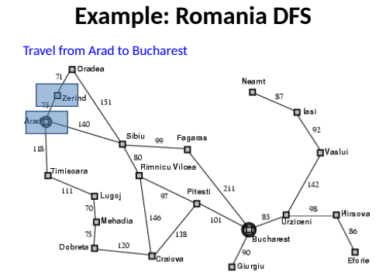
4.1 Introduction
4.2 Breadth first search
4.3 Depth first search
4.4 Difference between BFS and DFS
4.5 Uniform cost search
4.6 Depth-limited search
4.7 Iterative-deeping DFs
4.8 Bidirectional Search
4.9 Comparison of uninformed search

Slide 40
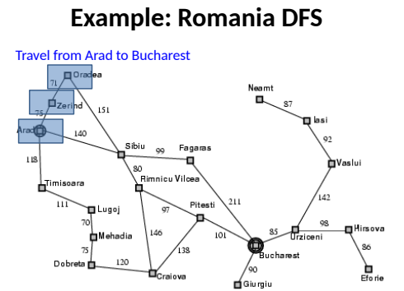
4.1 Introduction
4.2 Breadth first search
4.3 Depth first search
4.4 Difference between BFS and DFS
4.5 Uniform cost search
4.6 Depth-limited search
4.7 Iterative-deeping DFs
4.8 Bidirectional Search
4.9 Comparison of uninformed search

Slide 41
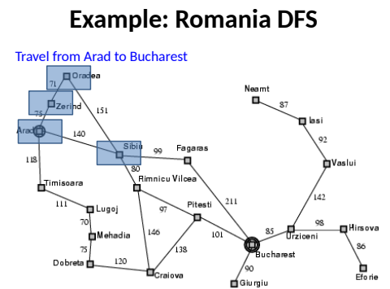
4.1 Introduction
4.2 Breadth first search
4.3 Depth first search
4.4 Difference between BFS and DFS
4.5 Uniform cost search
4.6 Depth-limited search
4.7 Iterative-deeping DFs
4.8 Bidirectional Search
4.9 Comparison of uninformed search

Slide 42
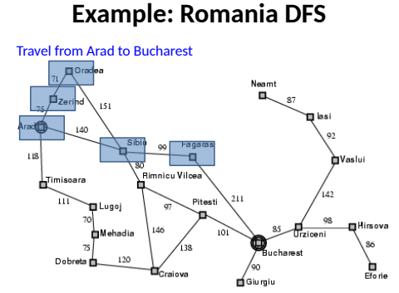
4.1 Introduction
4.2 Breadth first search
4.3 Depth first search
4.4 Difference between BFS and DFS
4.5 Uniform cost search
4.6 Depth-limited search
4.7 Iterative-deeping DFs
4.8 Bidirectional Search
4.9 Comparison of uninformed search

Slide 43
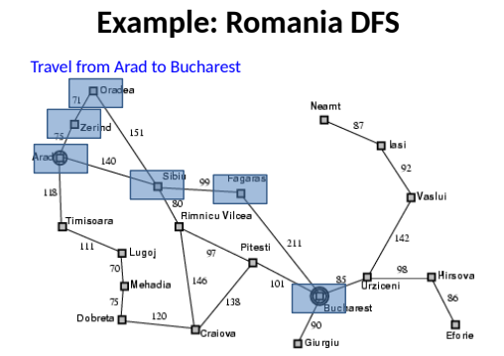
4.1 Introduction
4.2 Breadth first search
4.3 Depth first search
4.4 Difference between BFS and DFS
4.5 Uniform cost search
4.6 Depth-limited search
4.7 Iterative-deeping DFs
4.8 Bidirectional Search
4.9 Comparison of uninformed search

Slide 44
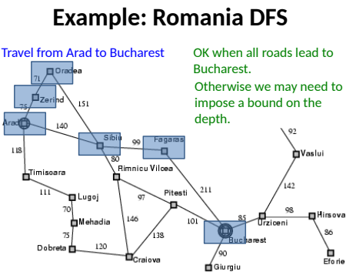
4.1 Introduction
4.2 Breadth first search
4.3 Depth first search
4.4 Difference between BFS and DFS
4.5 Uniform cost search
4.6 Depth-limited search
4.7 Iterative-deeping DFs
4.8 Bidirectional Search
4.9 Comparison of uninformed search

Slide 45
Evaluation
4.1 Introduction
4.2 Breadth first search
4.3 Depth first search
4.4 Difference between BFS and DFS
4.5 Uniform cost search
4.6 Depth-limited search
4.7 Iterative-deeping DFs
4.8 Bidirectional Search
4.9 Comparison of uninformed search
b: branching factor
d: depth of shallowest goal node
m: maximal depth of a leaf node
Depth-first search is:
Complete only for finite search tree
Not optimal
Number of nodes generated: 1 + b + b² + … + b^{m} = O(b^{m})
Time complexity is O(b^{m})
Space complexity is O(bm) [or O(m)]
[Reminder: Breadth-first requires O(b^{d}) time and space]

Slide 46
Difference between BFS and DFS
4.1 Introduction
4.2 Breadth first search
4.3 Depth first search
4.4 Difference between BFS and DFS
4.5 Uniform cost search
4.6 Depth-limited search
4.7 Iterative-deeping DFs
4.8 Bidirectional Search
4.9 Comparison of uninformed search
BASIS FOR COMPARISON | BFS | DFS
Basic | Vertex-based algorithm | Edge-based algorithm
Data structure used to store the nodes | Queue | Stack
Memory consumption | Inefficient | Efficient
Structure of the constructed tree | Wide and short | Narrow and long
Traversing fashion | Oldest unvisited vertices are explored at first. | Vertices along the edge are explored in the beginning.
Optimality | Optimal for finding the shortest distance, not in cost. | Not optimal
Application | Examines bipartite graph, connected component and shortest path present in a graph. | Examines two-edge connected graph, strongly connected graph, acyclic graph and topological order.

Slide 47
Uniform cost search
4.1 Introduction
4.2 Breadth first search
4.3 Depth first search
4.4 Difference between BFS and DFS
4.5 Uniform cost search
4.6 Depth-limited search
4.7 Iterative-deeping DFs
4.8 Bidirectional Search
4.9 Comparison of uninformed search
We factor in the cost of each step (e.g., distance form current state to the neighbors). Assumption: costs are non-negative.
g(n) = cost so far to reach n
Queue → ordered by cost
If all the steps are the same → breadth-first search is optimal since it always expands the shallowest (least cost)!
Uniform-cost search → expand first the nodes with lowest cost (instead of depth).
Does it ring a bell?

Slide 48
Uniform cost search
4.1 Introduction
4.2 Breadth first search
4.3 Depth first search
4.4 Difference between BFS and DFS
4.5 Uniform cost search
4.6 Depth-limited search
4.7 Iterative-deeping DFs
4.8 Bidirectional Search
4.9 Comparison of uninformed search
Each arc has some cost c ≥ ε > 0
The cost of the path to each fringe node N is
g(N) = Σ costs of arcs
The goal is to generate a solution path of minimal cost
The queue FRINGE is sorted in increasing cost

Slide 49
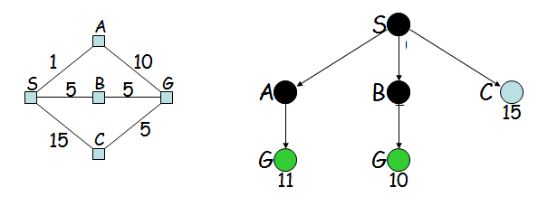
Uniform cost search (Example )
4.1 Introduction
4.2 Breadth first search
4.3 Depth first search
4.4 Difference between BFS and DFS
4.5 Uniform cost search
4.6 Depth-limited search
4.7 Iterative-deeping DFs
4.8 Bidirectional Search
4.9 Comparison of uninformed search

Slide 50
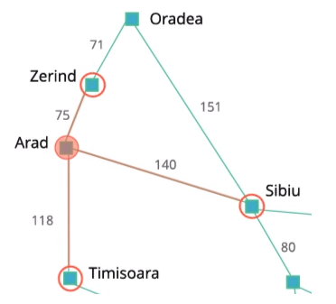
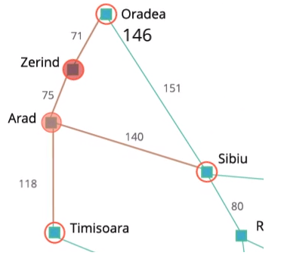
4.1 Introduction
4.2 Breadth first search
4.3 Depth first search
4.4 Difference between BFS and DFS
4.5 Uniform cost search
4.6 Depth-limited search
4.7 Iterative-deeping DFs
4.8 Bidirectional Search
4.9 Comparison of uninformed search
Uniform cost search , Also known as the Cheapest First Search, the Uniform Cost Search algorithm always chooses the frontier that has the cheapest path cost.
In our route-finding example, in the beginning, we have three frontiers: Zerind, Sibiu, and Timisoara. Zerind has the lowest path cost of 75, so Zerind will be chosen.
Then, we have three frontiers: Oradea, Sibiu, and Timisoara. Timisoara has the lowest path cost of 118, so we choose Timisoara.

Slide 51
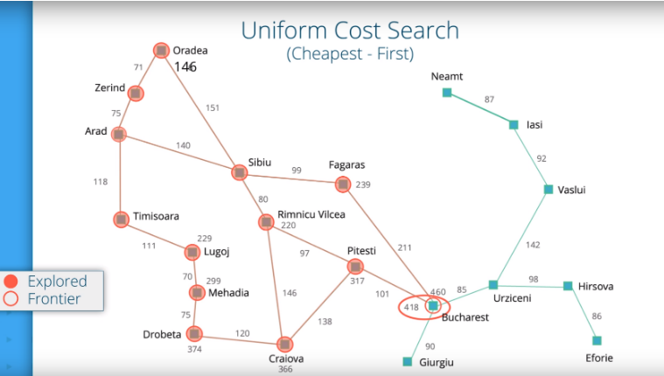
4.1 Introduction
4.2 Breadth first search
4.3 Depth first search
4.4 Difference between BFS and DFS
4.5 Uniform cost search
4.6 Depth-limited search
4.7 Iterative-deeping DFs
4.8 Bidirectional Search
4.9 Comparison of uninformed search

Slide 52
4.1 Introduction
4.2 Breadth first search
4.3 Depth first search
4.4 Difference between BFS and DFS
4.5 Uniform cost search
4.6 Depth-limited search
4.7 Iterative-deeping DFs
4.8 Bidirectional Search
4.9 Comparison of uninformed search
For Uniform Cost Search, it is essential to continue searching even when the goal state is reached. If you stop immediately after finding a path, then you cannot guarantee that it is the shortest path, since there might have been a frontier that could have reached the goal state faster.
For example, In our Arad to Bucharest example, the first path you find (Arad - Sibiu - Fagaras - Bucharest) with the uniform cost search has the cost of 460. However, there is another path (Arad - Sibiu - Rimnicu Vilcea - Pitesti - Bucharest) that as the cost of 418.
Therefore, you need to wait until all the other frontiers have a path cost higher than the path cost of your path to the goal state. This is ensured exactly when your path to the goal state is chosen from the list of frontiers, since by definition, uniform cost search chooses the frontier with least path cost.

Slide 53
4.1 Introduction
4.2 Breadth first search
4.3 Depth first search
4.4 Difference between BFS and DFS
4.5 Uniform cost search
4.6 Depth-limited search
4.7 Iterative-deeping DFs
4.8 Bidirectional Search
4.9 Comparison of uninformed search
Expand least-cost (of path to) unexpanded node
(e.g. useful for finding shortest path on map) Implementation:
fringe = queue ordered by path cost g – cost of reaching a node
Complete? Yes, if step cost ≥ ε (>0) Time? # of nodes with g ≤ cost of optimal solution (C*),
O(b^{(1+⎣C*/ ε⎦})
Space? # of nodes with g ≤ cost of optimal solution,
O(b^{(1+⎣C*/ ε⎦})
Optimal? Yes – nodes expanded in increasing order of g(n)
Note: Some subtleties (e.g. checking for goal state).

Slide 54
Depth-limited search
4.1 Introduction
4.2 Breadth first search
4.3 Depth first search
4.4 Difference between BFS and DFS
4.5 Uniform cost search
4.6 Depth-limited search
4.7 Iterative-deeping DFs
4.8 Bidirectional Search
4.9 Comparison of uninformed search
Depth-first with depth cutoff k (depth below which nodes are not expanded)
Three possible outcomes:
Solution
Failure (no solution)
Cutoff (no solution within cutoff)

Slide 55
Depth-limited search
4.1 Introduction
4.2 Breadth first search
4.3 Depth first search
4.4 Difference between BFS and DFS
4.5 Uniform cost search
4.6 Depth-limited search
4.7 Iterative-deeping DFs
4.8 Bidirectional Search
4.9 Comparison of uninformed search
The problem related to the unbounded tree can be alleviated by providing the DFS with the predetermined depth limit of l.
The nodes at depth l are considered to have no successors. This approach is known as depth-limited search.
This search solves the infinite path problem, however, addition source of incompleteness is introduced if we choose l less than d, i.e., shallowest goal is beyond the depth limit (this is not likely in case of d being unknown).
This search will also remain non-optimal if l selected is great than d.
It has the time complexity of O(bl) and its space complexity is O(bl). DFS can be seen as the special case of depth-limited search with l = É .

Slide 56
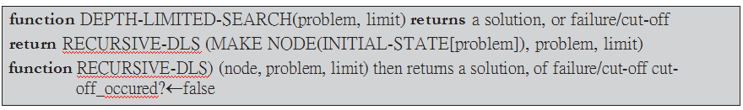
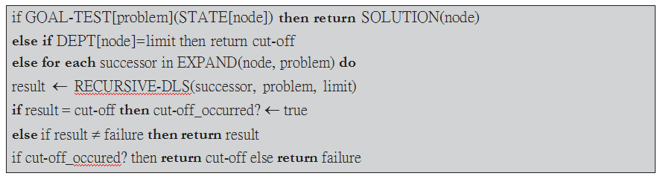
Depth-limited search
4.1 Introduction
4.2 Breadth first search
4.3 Depth first search
4.4 Difference between BFS and DFS
4.5 Uniform cost search
4.6 Depth-limited search
4.7 Iterative-deeping DFs
4.8 Bidirectional Search
4.9 Comparison of uninformed search
Pseudo-code

Slide 57
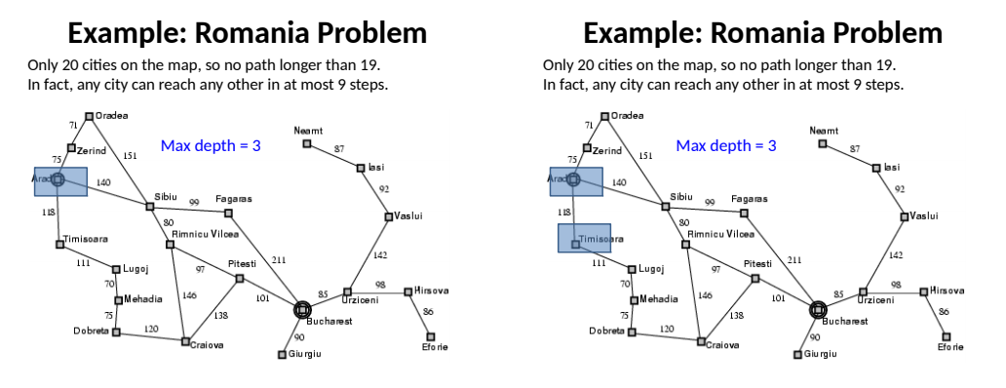
Depth Limited Search
4.1 Introduction
4.2 Breadth first search
4.3 Depth first search
4.4 Difference between BFS and DFS
4.5 Uniform cost search
4.6 Depth-limited search
4.7 Iterative-deeping DFs
4.8 Bidirectional Search
4.9 Comparison of uninformed search

Slide 58
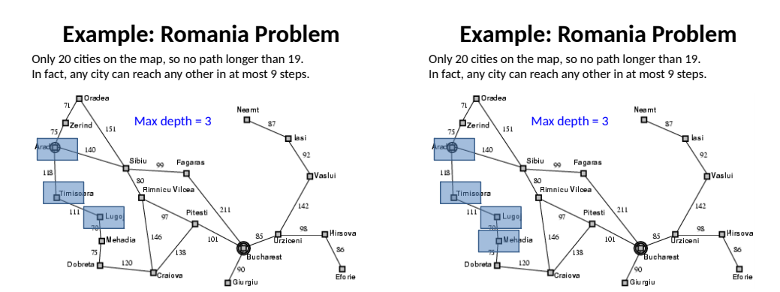
Depth Limited Search
4.1 Introduction
4.2 Breadth first search
4.3 Depth first search
4.4 Difference between BFS and DFS
4.5 Uniform cost search
4.6 Depth-limited search
4.7 Iterative-deeping DFs
4.8 Bidirectional Search
4.9 Comparison of uninformed search

Slide 59
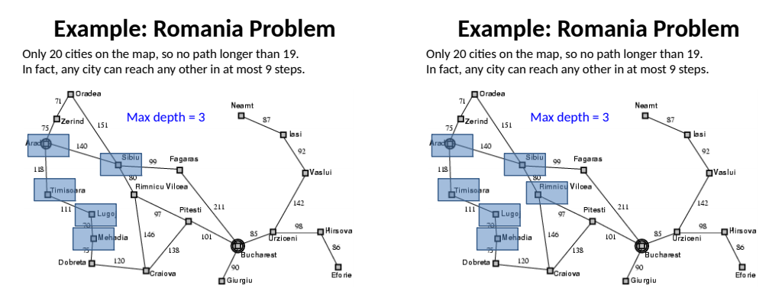
Depth Limited Search
4.1 Introduction
4.2 Breadth first search
4.3 Depth first search
4.4 Difference between BFS and DFS
4.5 Uniform cost search
4.6 Depth-limited search
4.7 Iterative-deeping DFs
4.8 Bidirectional Search
4.9 Comparison of uninformed search

Slide 60
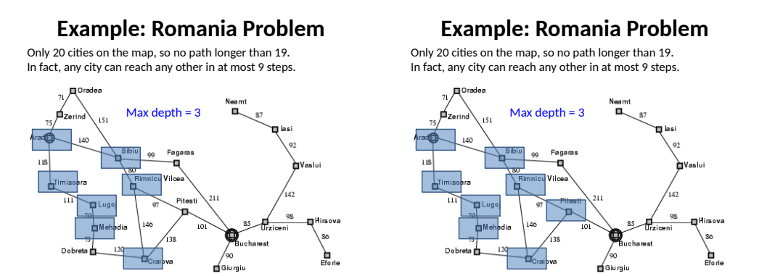
Depth Limited Search
4.1 Introduction
4.2 Breadth first search
4.3 Depth first search
4.4 Difference between BFS and DFS
4.5 Uniform cost search
4.6 Depth-limited search
4.7 Iterative-deeping DFs
4.8 Bidirectional Search
4.9 Comparison of uninformed search

Slide 61
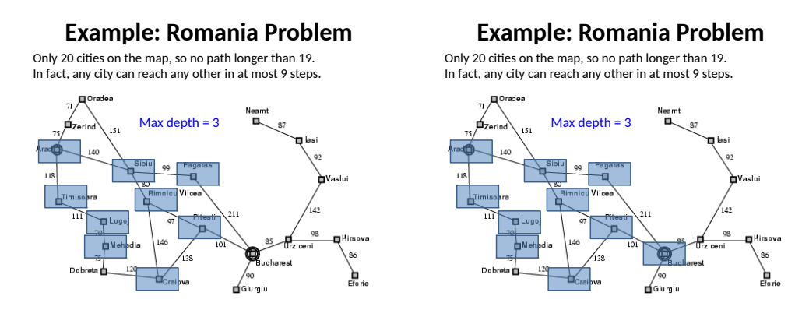
4.1 Introduction
4.2 Breadth first search
4.3 Depth first search
4.4 Difference between BFS and DFS
4.5 Uniform cost search
4.6 Depth-limited search
4.7 Iterative-deeping DFs
4.8 Bidirectional Search
4.9 Comparison of uninformed search

Slide 62
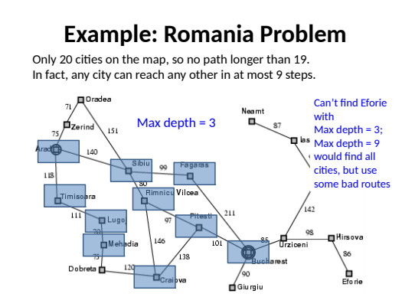
Depth Limited Search
4.1 Introduction
4.2 Breadth first search
4.3 Depth first search
4.4 Difference between BFS and DFS
4.5 Uniform cost search
4.6 Depth-limited search
4.7 Iterative-deeping DFs
4.8 Bidirectional Search
4.9 Comparison of uninformed search

Slide 63
Iterative deeping DFs
4.1 Introduction
4.2 Breadth first search
4.3 Depth first search
4.4 Difference between BFS and DFS
4.5 Uniform cost search
4.6 Depth-limited search
4.7 Iterative-deeping DFs
4.8 Bidirectional Search
4.9 Comparison of uninformed search
Iterative deepening search (or iterative deepening first search) is the general strategy. This is most often used in combination with DFS which finds the best depth limit. It is the depth limited search in iteration. It does this by gradually the limit from 0, then to 1 and then to 2 and so on. This happens when the depth limit reaches d that is the depth of the shallowest goal node.
Iterative deepening DFS combines the benefits of DFS and BFS. As compared to DFS, its memory requirements are modest O(bd).
In iterative deepening DFS, the nodes on the bottom level (depth d) are generated once, the nodes on the next level are generated twice and it continues up to the children of root which are generated d times. Therefore, the total number of nodes generated is
N(IDS) = d(b) + (d – 1)b2 + … + (1)bd

Slide 64
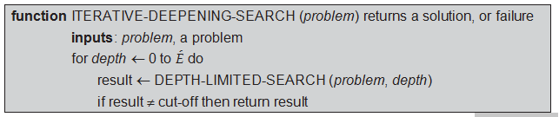
Iterative deeping DFs
4.1 Introduction
4.2 Breadth first search
4.3 Depth first search
4.4 Difference between BFS and DFS
4.5 Uniform cost search
4.6 Depth-limited search
4.7 Iterative-deeping DFs
4.8 Bidirectional Search
4.9 Comparison of uninformed search
This provides the time complexity of O(bd). This can be compared with the nodes generated by BFS:
N(BFS) = b + b2 + … + bd + (bd + 1 – b)
Observe that BFS generates nodes at depth, d + 1. Iterative deepening DFS does not. Hence, iterative deepening DFS is faster than the BFS in spite of repeated generation of states.
ALGORITHM

Slide 65
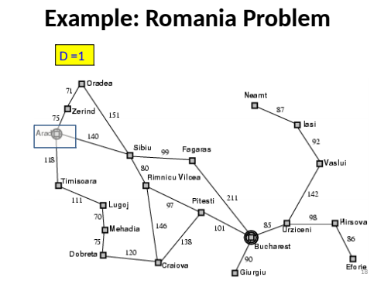
Iterative-deeping DFs
4.1 Introduction
4.2 Breadth first search
4.3 Depth first search
4.4 Difference between BFS and DFS
4.5 Uniform cost search
4.6 Depth-limited search
4.7 Iterative-deeping DFs
4.8 Bidirectional Search
4.9 Comparison of uninformed search

Slide 66
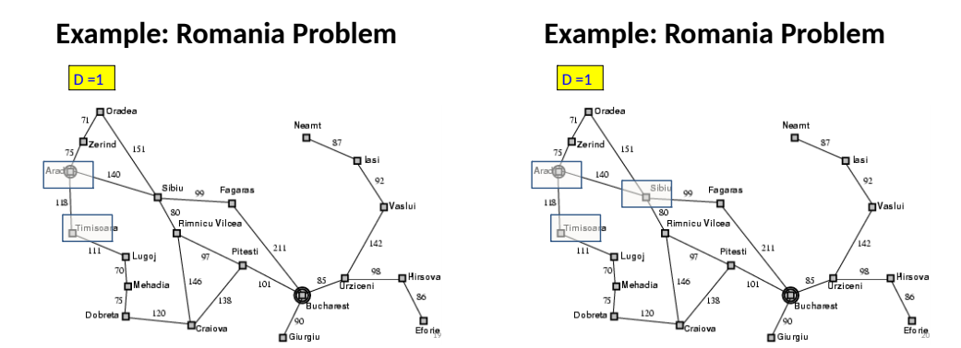
Iterative-deeping DFs
4.1 Introduction
4.2 Breadth first search
4.3 Depth first search
4.4 Difference between BFS and DFS
4.5 Uniform cost search
4.6 Depth-limited search
4.7 Iterative-deeping DFs
4.8 Bidirectional Search
4.9 Comparison of uninformed search

Slide 67
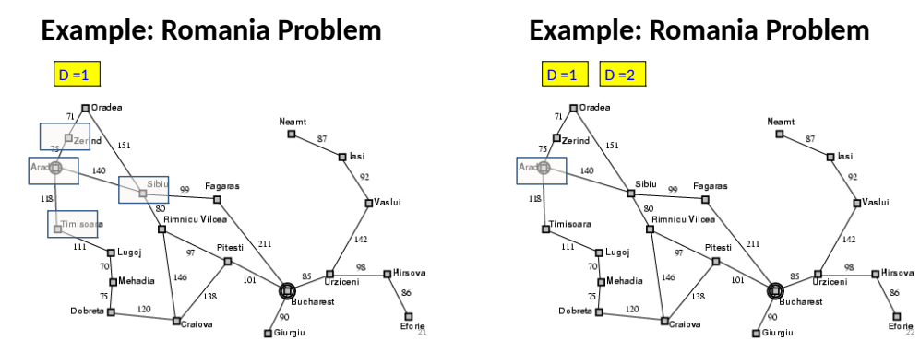
Iterative-deeping DFs
4.1 Introduction
4.2 Breadth first search
4.3 Depth first search
4.4 Difference between BFS and DFS
4.5 Uniform cost search
4.6 Depth-limited search
4.7 Iterative-deeping DFs
4.8 Bidirectional Search
4.9 Comparison of uninformed search

Slide 68
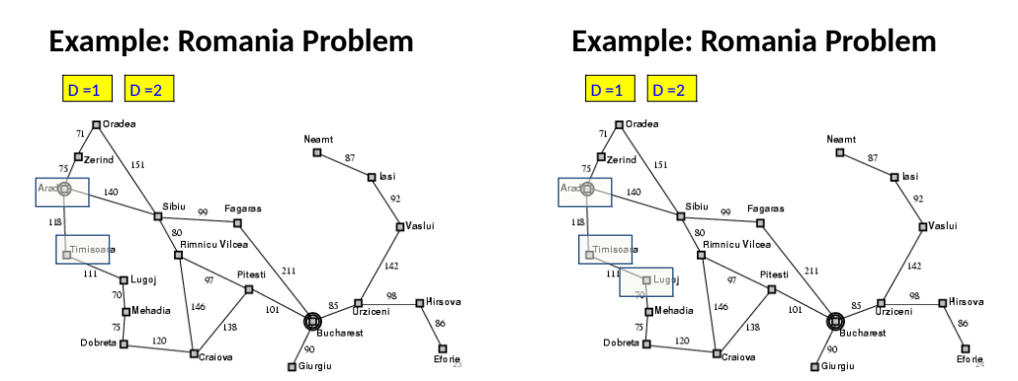
Iterative-deeping DFs
4.1 Introduction
4.2 Breadth first search
4.3 Depth first search
4.4 Difference between BFS and DFS
4.5 Uniform cost search
4.6 Depth-limited search
4.7 Iterative-deeping DFs
4.8 Bidirectional Search
4.9 Comparison of uninformed search

Slide 69
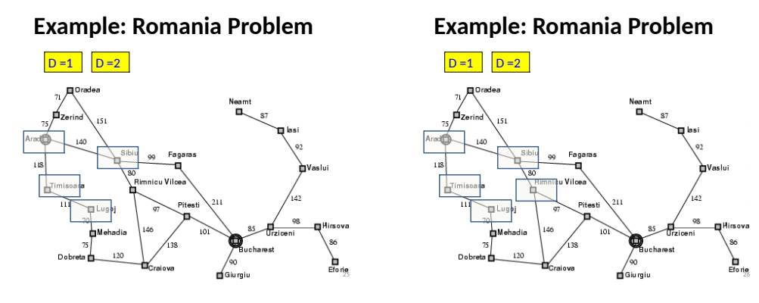
Iterative-deeping DFs
4.1 Introduction
4.2 Breadth first search
4.3 Depth first search
4.4 Difference between BFS and DFS
4.5 Uniform cost search
4.6 Depth-limited search
4.7 Iterative-deeping DFs
4.8 Bidirectional Search
4.9 Comparison of uninformed search

Slide 70
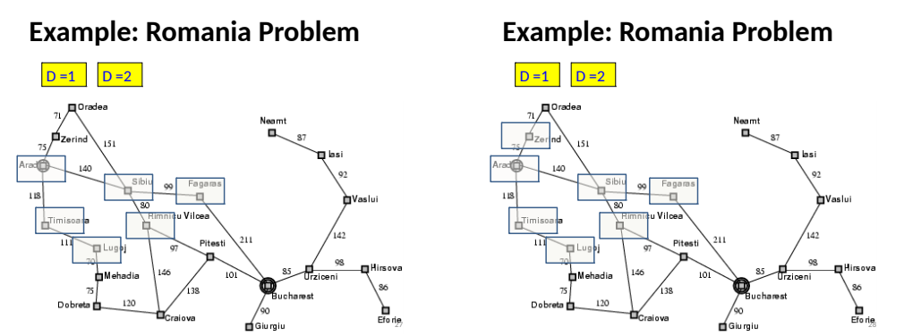
Iterative-deeping DFs
4.1 Introduction
4.2 Breadth first search
4.3 Depth first search
4.4 Difference between BFS and DFS
4.5 Uniform cost search
4.6 Depth-limited search
4.7 Iterative-deeping DFs
4.8 Bidirectional Search
4.9 Comparison of uninformed search

Slide 71
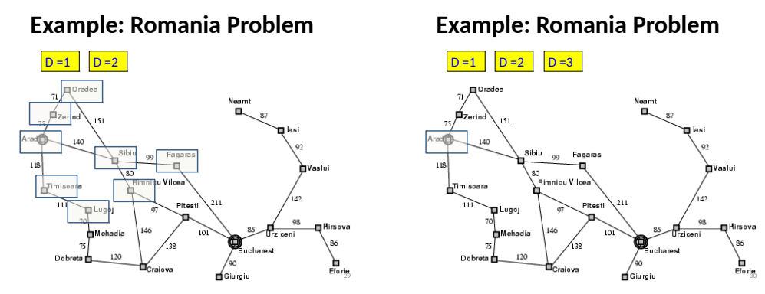
Iterative-deeping DFs
4.1 Introduction
4.2 Breadth first search
4.3 Depth first search
4.4 Difference between BFS and DFS
4.5 Uniform cost search
4.6 Depth-limited search
4.7 Iterative-deeping DFs
4.8 Bidirectional Search
4.9 Comparison of uninformed search

Slide 72
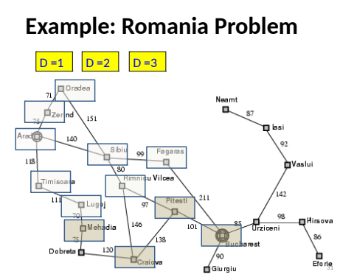
Iterative-deeping DFs
4.1 Introduction
4.2 Breadth first search
4.3 Depth first search
4.4 Difference between BFS and DFS
4.5 Uniform cost search
4.6 Depth-limited search
4.7 Iterative-deeping DFs
4.8 Bidirectional Search
4.9 Comparison of uninformed search

Slide 73
Bidirectional Search
4.1 Introduction
4.2 Breadth first search
4.3 Depth first search
4.4 Difference between BFS and DFS
4.5 Uniform cost search
4.6 Depth-limited search
4.7 Iterative-deeping DFs
4.8 Bidirectional Search
4.9 Comparison of uninformed search
Search forward from the start state and backward from the goal state simultaneously and stop when the two searches meet in the middle.
If branching factor=b, and solution at depth d, then O(2b^{d/2}) steps.
B=10, d=6 then BFS needs 1,111,111 nodes and bidirectional needs only 2,222.

Slide 74
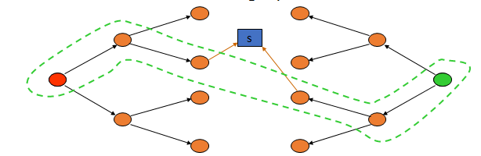
Bidirectional Strategy
4.1 Introduction
4.2 Breadth first search
4.3 Depth first search
4.4 Difference between BFS and DFS
4.5 Uniform cost search
4.6 Depth-limited search
4.7 Iterative-deeping DFs
4.8 Bidirectional Search
4.9 Comparison of uninformed search
2 fringe queues: FRINGE1 and FRINGE2
Time and space complexity is O(b^{d/2}) << O(b^{d}) if both trees have the same branching factor b
Question: What happens if the branching factor is different in each direction?

Slide 75
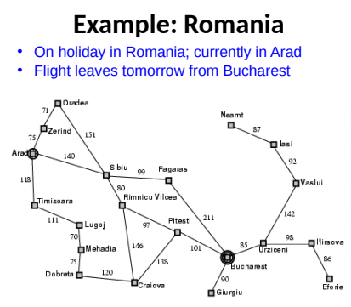
4.1 Introduction
4.2 Breadth first search
4.3 Depth first search
4.4 Difference between BFS and DFS
4.5 Uniform cost search
4.6 Depth-limited search
4.7 Iterative-deeping DFs
4.8 Bidirectional Search
4.9 Comparison of uninformed search

Slide 76
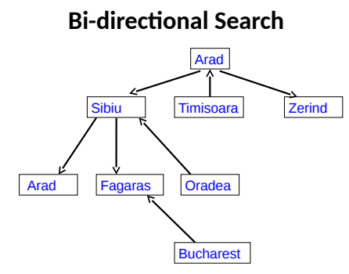
4.1 Introduction
4.2 Breadth first search
4.3 Depth first search
4.4 Difference between BFS and DFS
4.5 Uniform cost search
4.6 Depth-limited search
4.7 Iterative-deeping DFs
4.8 Bidirectional Search
4.9 Comparison of uninformed search

Slide 77
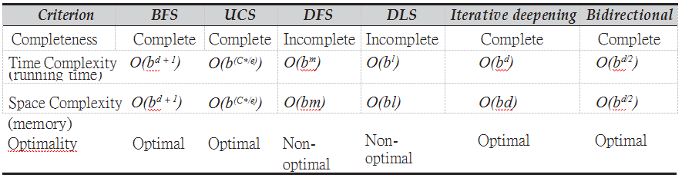
Comparison of ununiformed search
4.1 Introduction
4.2 Breadth first search
4.3 Depth first search
4.4 Difference between BFS and DFS
4.5 Uniform cost search
4.6 Depth-limited search
4.7 Iterative-deeping DFs
4.8 Bidirectional Search
4.9 Comparison of uninformed search
Here, in the table,
b – Branching factor of each node (how many branches are
created from each node of the search tree).
d – Depth of the shallowest solution (the depth of the place where the GOAL node is located form the root node).
m – Maximum depth of the search tree.
l – Limited depth of the search tree used in depth-limited search. C* – Cost of the optimal solution (based on the path cost).
E – Cost of every action.

Slide 78

Dr. Nilakshi Jain Email ID : nilakshijain1986@gmail.com
Thank you

